Slide 1
Reversa.ai Legal Publication Data Analysis
Andrew Darwin, Tony Lomeli, Ethan Zheng, J.T. Reilly
Notes:
Basically, what Reversa.ai does is that they transform regulatory risk into a competitive advantage for companies and they try to solve the problem of overregulation using AI. Why is this important? Well, thousands of pages of regulations are published every day. Previously, it took hours to read; now, it's resolved in seconds.

Slide 2
Project Overview
Goal:
Analyze a structured dataset of legal publications extracted from Spanish official bulletins.
Identify patterns across legal domains (ramas jurídicas) and industrial divisions (divisiones).
Prepare a cleaner dataset to support clear, insightful visualizations and interpretable trends in legal data.
Tools:
Pandas for data manipulation
NumPy for numerical operations
Seaborn/Matplotlib for visualization
Scikit-learn for the machine learning model
Google Colab + Google Drive for cloud execution and storage
Notes:
Basically, what Reversa.ai does is that they transform regulatory risk into a competitive advantage for companies and they try to solve the problem of overregulation using AI. Why is this important? Well, thousands of pages of regulations are published every day. Previously, it took hours to read; now, it's resolved in seconds.

Slide 3
Dataset Description
Extracted from the Boletín Oficial del Estado (BOE) — the official gazette of Spain that publishes legal, administrative, and regulatory texts.
Provided in CSV format as UCLABOE.csv, located in a shared Google Drive folder.
Column | Description
titulo | Full legal title of the document.
fecha_publicacion | Date the document was published. This column is further decomposed into: year, month, and day to allow for temporal analysis.
num_paginas | Number of pages in the document. Used as a proxy for document length or complexity.
divisiones[0-13] | Up to 14 columns indicating the economic/industry sectors affected by the document.
ramas_juridicas[0-14] | Up to 15 columns indicating the legal domains associated with the document.
rango | Type of norm

Slide 4
Data Cleaning & Preprocessing
Date Conversion:
‘Fecha_publicacion’ converted from string to datetime using ‘pd.to_datetime()’
Handling Missing Pages:
‘Num_paginas’ had approximately 10% missing values (NA or equal to 0), which were imputed using the median value for corresponding type of law category (rango)
Rango only category with no missingness, low variability in page numbers
Restructuring Categorical Data:
The dataset originally had fields like ‘divisiones[0],’ ‘divisiones[1],’ …, ‘divisiones[13]’ to include multiple labels for a single publication
Aggregated fields into a single column

Slide 5
Dealing with Missing Data
Issue:
Many entries had missing or unhelpful values in ‘divisiones’ and ‘ramas_juridicas’ (Would state ‘No identificado’ or it was empty).
Solution:
Created a custom function that was used to quantify this issue.
Extracted keywords from ‘titulo’(title of the publication) to infer probable divisions or legal branches.
For example: if a title includes “laboral”, it might belong to the “Labor Law” category.
This was a rule-based NLP approximation; it wasn’t the most perfect approach, but it adds structure.

Slide 6
Imputation results and relevance
Results
Field | Missing Before | Missing After | Reduction (%)
divisiones | 1127 rows | 950 rows | 15.7% ↓
ramas_juridicas | 1174 rows | 982 rows | 16.4% ↓
These reductions improved the label coverage of the dataset, enhancing the reliability of downstream analyses.
This also increases the statistical power and interpretive depth of our analysis.
Remaining missing values were labeled as “No identificado” for uniformity with preexisting data
Notes:
Also mention that we checked to see if any of the divisiones or ramas_juridicas entries were inputted incorrectly or not uniform but they all fit into the categories provided

Slide 7
Visualizations

Slide 8
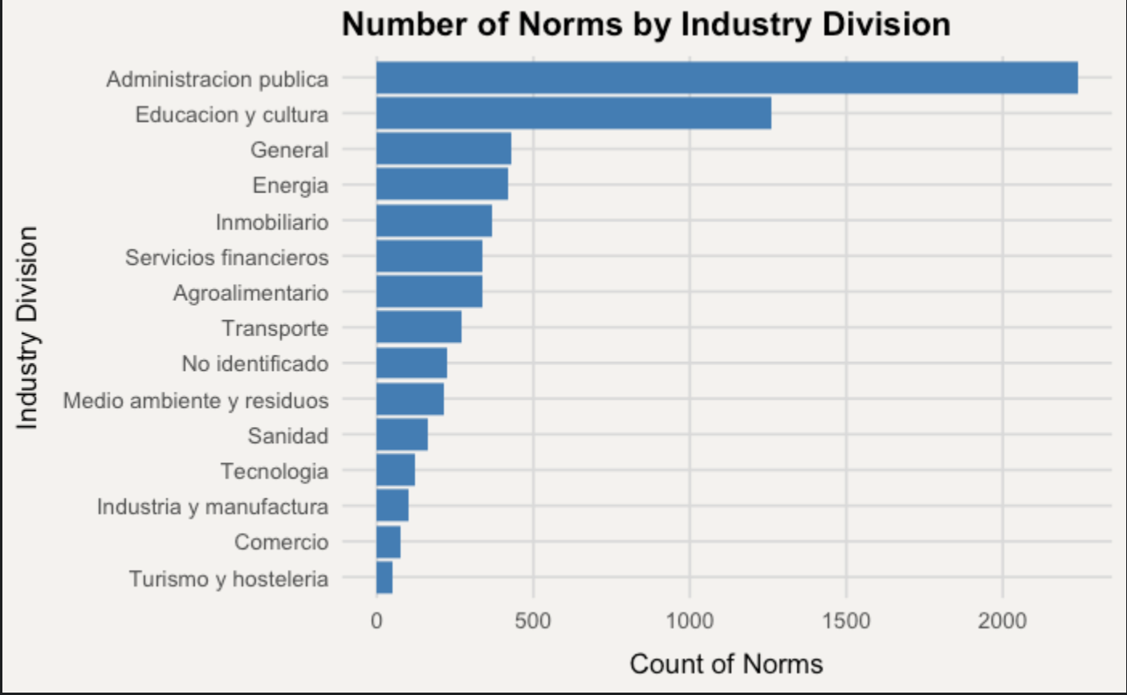
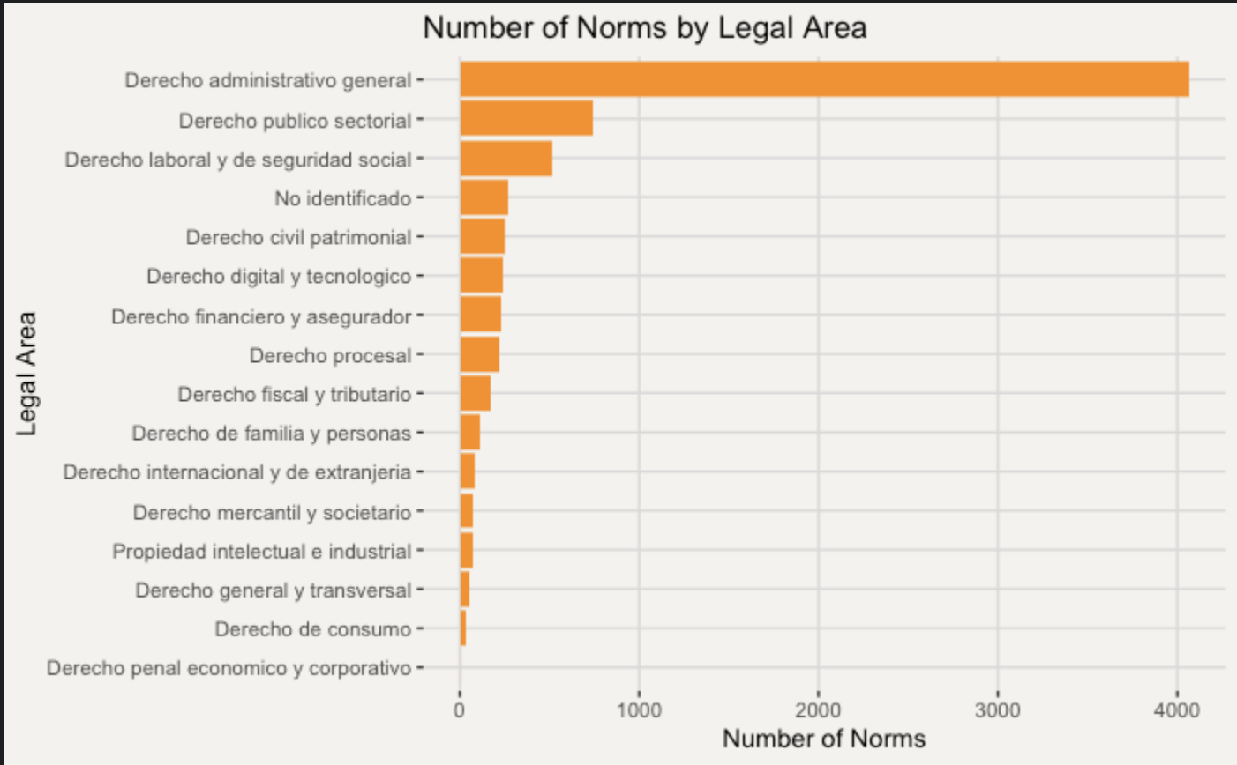
Norms by Industry, Legal Area, and Law Type

Slide 9
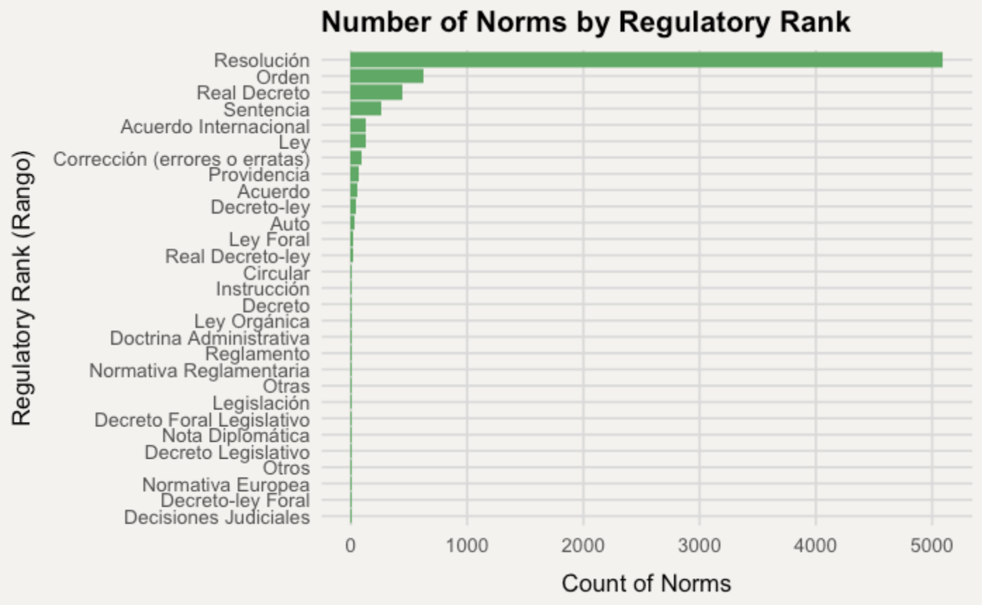
Norms by Industry, Legal Area, and Law Type
Notes:
Number of publications all highly skewed towards the general categories

Slide 10
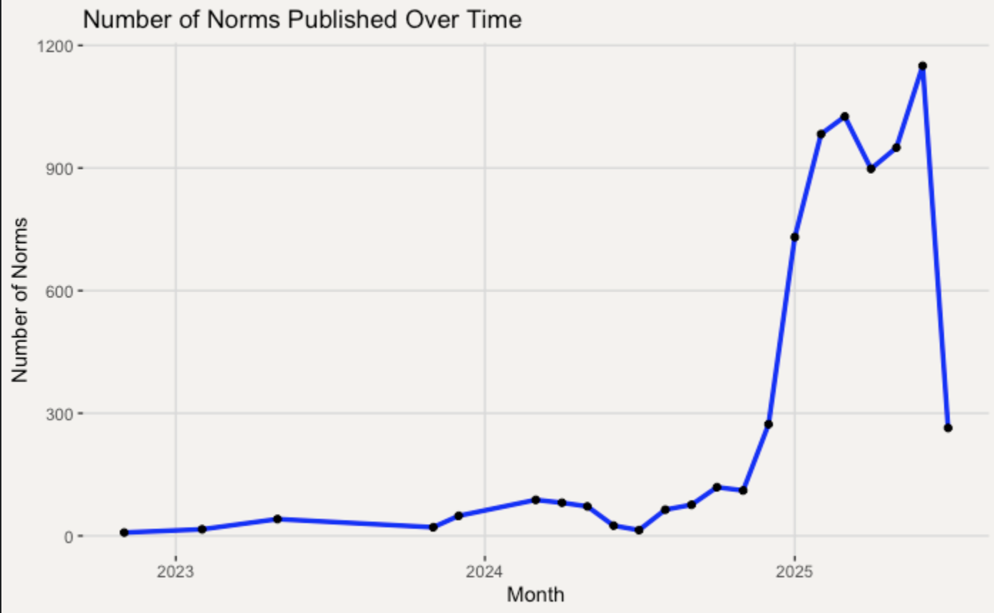
Publications over time
Massive growth in number of publications in 2025
More publications towards start/middle of years
On downward trend

Slide 11
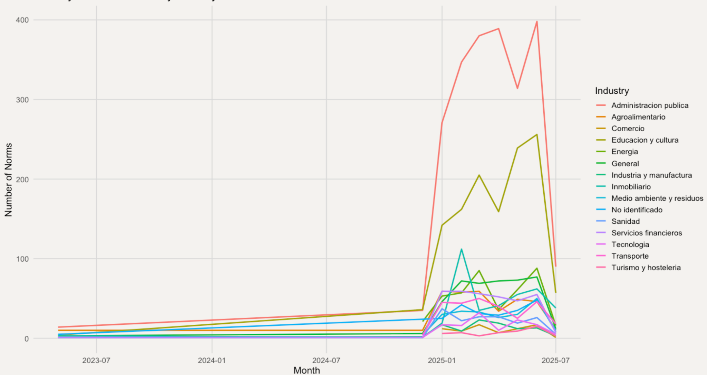

Publications over time by Industry
Same trends as overall publications count
Legal area trends look nearly identical, with general administration being the largest

Slide 12
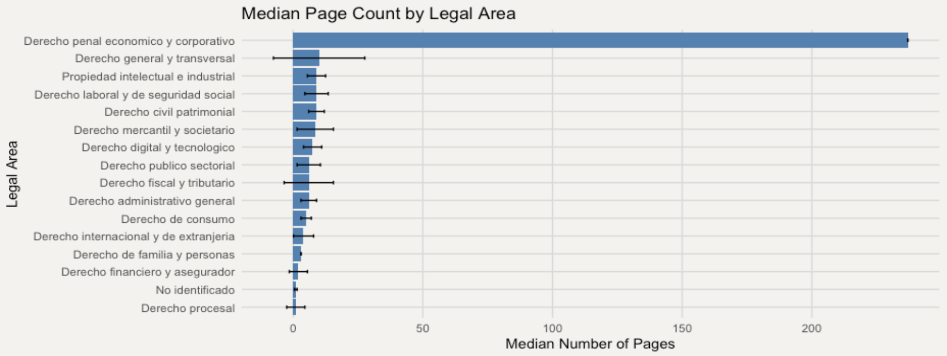

Page Count by Legal Area
- Longest documents are economic & corporate criminal law by far
- Most have low variation, except for General Law
- understandable as a broad topic

Slide 13
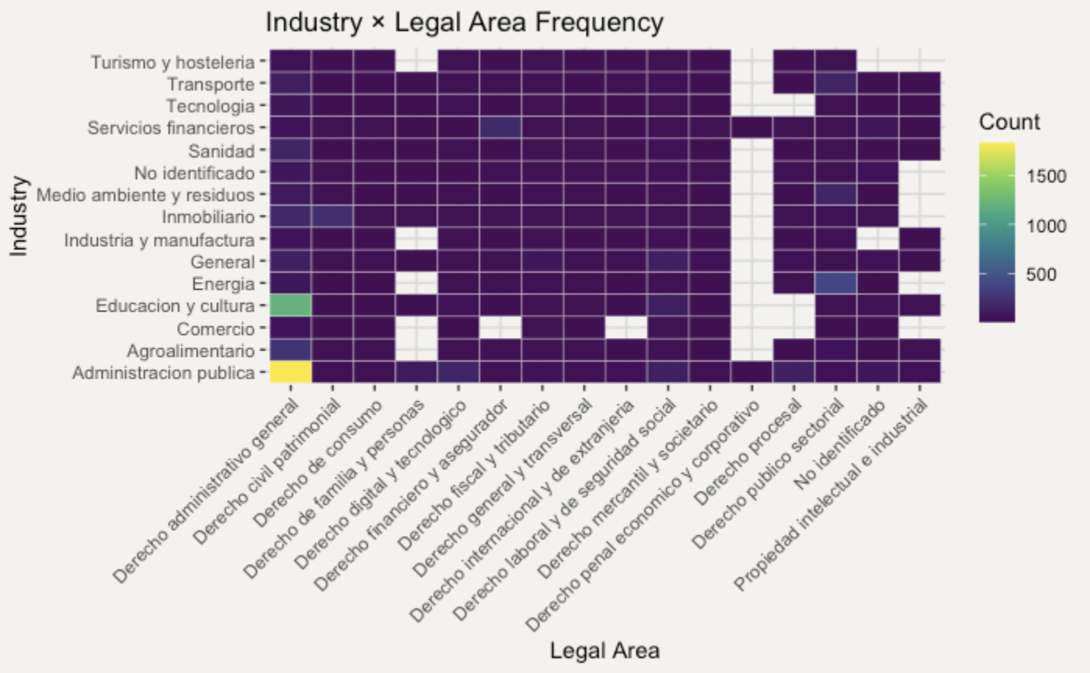
Legal Area Intersections
Public Administration + General Administrative Law
Education & Culture + General Administrative Law
Energy + Sectorial Public

Slide 14
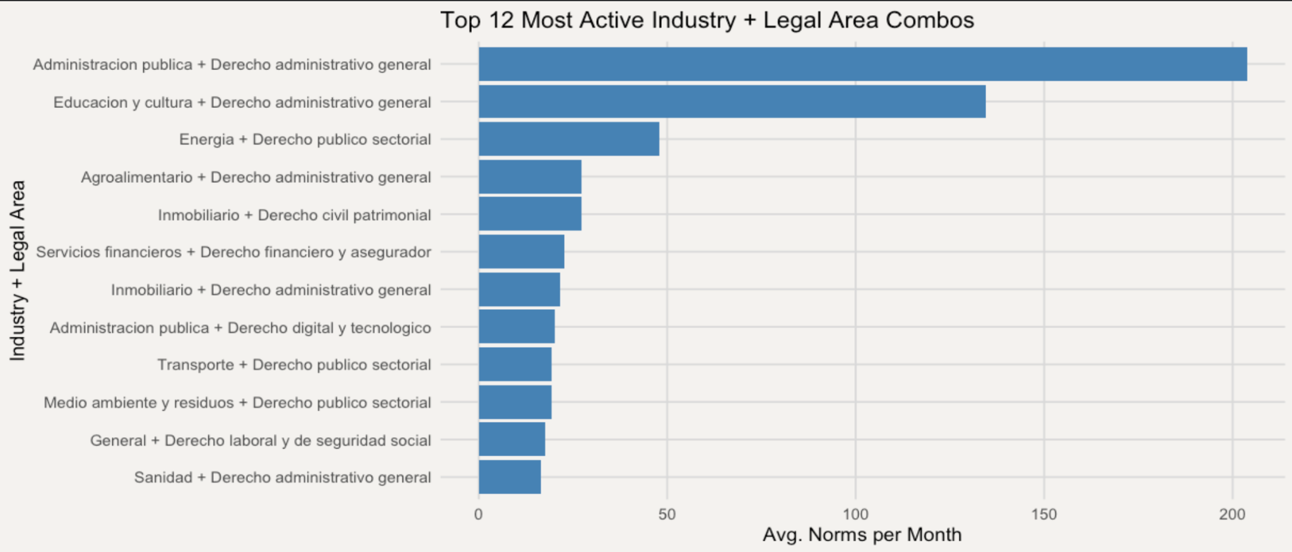
Intersections Cont’d

Slide 15
Key Insights
Public Administration, Education, and Energy industries dominate in volume and frequency
General and Sectoral Public Law are the most frequent legal areas across industries
highlights the need for legal tech tools tailored to public regulation.
Corporate and Economic Criminal Law has the largest median page count by a large margin
Royal Decrees, Ministerial Orders, and Resolutions are most common types of norm
In general most documents seem to be published in the first half of a given year

Slide 16
Actionable Analysis
Prioritize Public Law NLP Models (Administrative & Sectoral Public Law)
Create more in depth summaries for economic and corporate law
Laws are more nuanced and lengthy, increasing risk of misinterpretation or omission in a summary
After completing analysis of one area, recommend related legal areas or industries with frequent overlap
Ie: Company reviewing Energy norms in Sectoral Public Law, recommend reviewing Environmental Law norms
Agricultural, Energy, and Education & Culture are most active sectors behind the general classes
Increase reporting & analysis frequency in first half of year to match higher publication volume
Highlight the overwhelming volume and complexity of regulations companies face
Emphasizes necessity and efficiency of AI-powered summaries
Ie: Economic & Corporate law avg. 200+ pages per publication

Slide 17
Overall Challenges:
Text Noise: Titles are inconsistent and may lack legal vocabulary and length.
Missing Values: Not always recoverable by rule-based imputation.
Sparse Multilabel Structure: Rows can be linked to multiple classes which can be hard to model without advanced techniques
Improvements:
Integrate with a dashboard or API.
Use datasets for laws and regulations outside of Spain.
Imputation logic should account for polysemy and synonymy in legal documents for greater understanding of context

Slide 18
Modeling

Slide 19
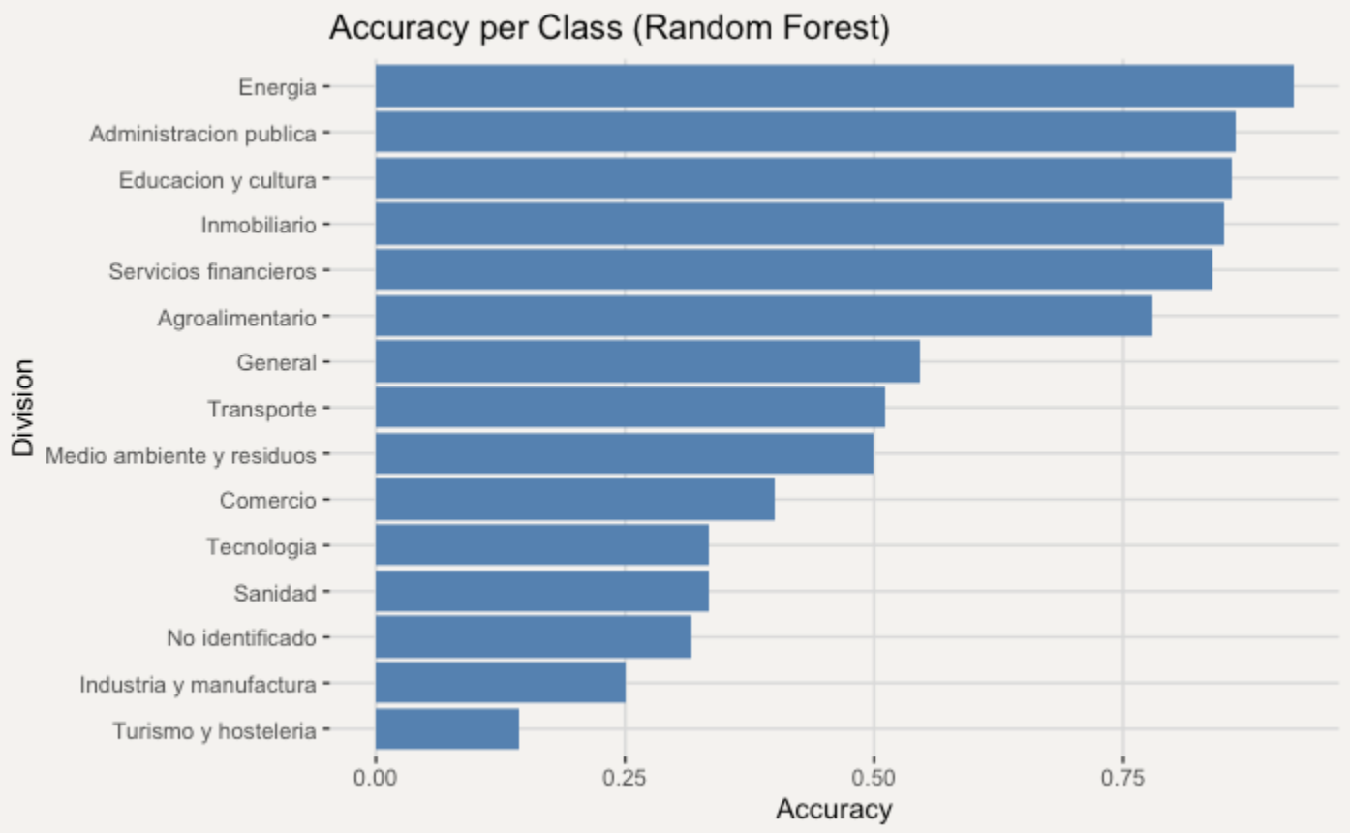
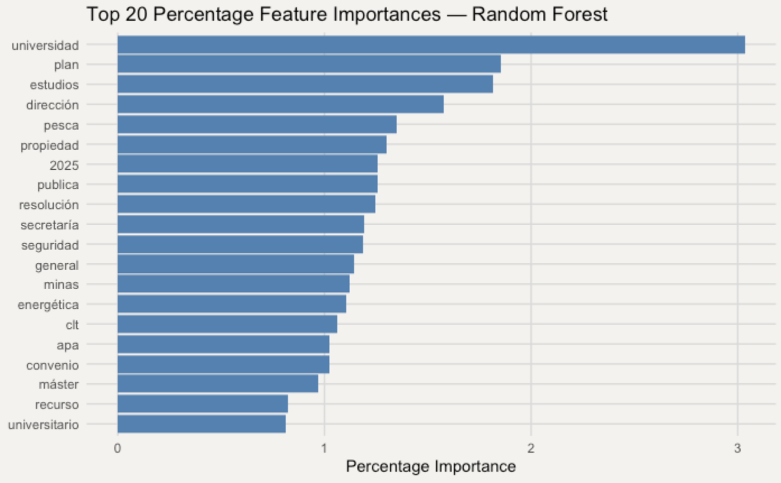
Random Forest Results
20%/80% Testing/Training Split
Overall Accuracy: 76.38%
Per Class Accuracy:
Most important words for the model fit:

Slide 20
Modeling Takeaways and Challenges:
Overall performance: – ~76 % test‑set accuracy on titles alone – Strong bias toward Administración Pública (majority class) inflates global score
Per‐class insights: – High accuracy (≈85 %) for “Energía” “Administración pública” – Poor performance (<30 %) on “Turismo y hostelería” and other underrepresented classes
Feature signals: – Top words (“universidad,” “plan,” “estudios,” etc.) drive decisions, but often reflect generic topics
Data limitations: – Titles only: very short and ambiguous for fine‐grained division, constraints learning model
Future Improvements:
Include abstract or summary column for each publication
Address class imbalance: – Oversample minority classes or use class‑weighted/loss‑sensitive models – Stratified CV that leaves out entire publication periods to test temporal generalization
Utilize advanced embeddings: – Fine‐tune a Spanish BERT or use contextualized transformers

Slide 21
Thank You!

